Slide 1
ISRA 5D data
Excel file: UK5 Data Set Definitions and Data Sets
Tab: ISRA 5D Fault Scanner Data
Location and values of the: small, medium and large spikes.
Notes:
Indices of the mentioned dates starts at 4525

Slide 2
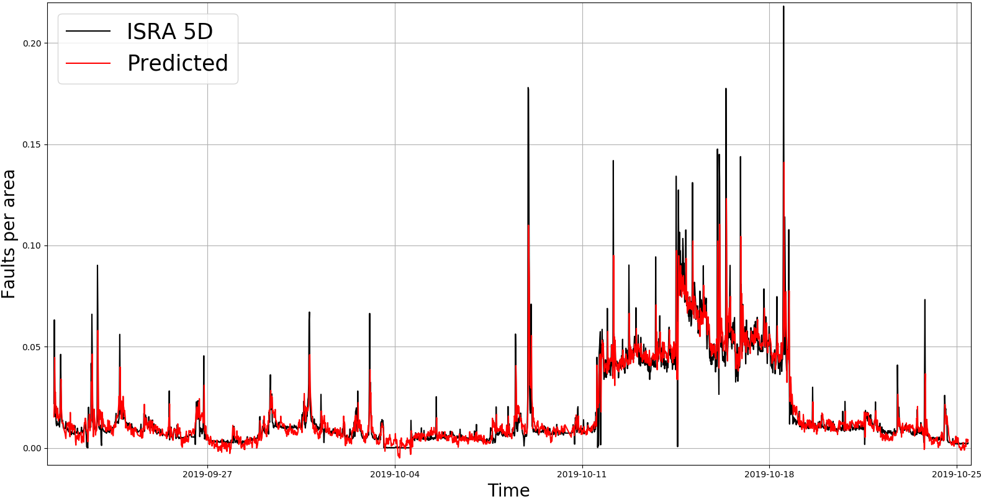
ISRA 5D data
1) Small
Notes:
Indices of the mentioned dates starts at 4525

Slide 3
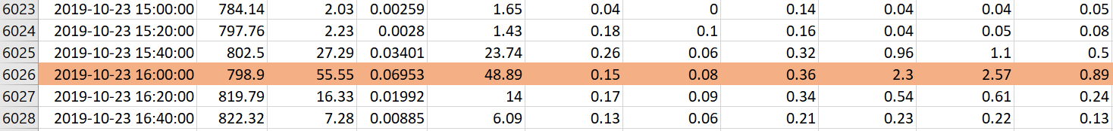
ISRA 5D data
Excel file: UK5 Data Set Definitions and Data Sets
Tab: ISRA 5D Fault Scanner Data
1) Small spike
Notes:
Indices of the mentioned dates starts at 4525

Slide 4
ISRA 5D data
2) Medium
Notes:
Indices of the mentioned dates starts at 4525

Slide 5
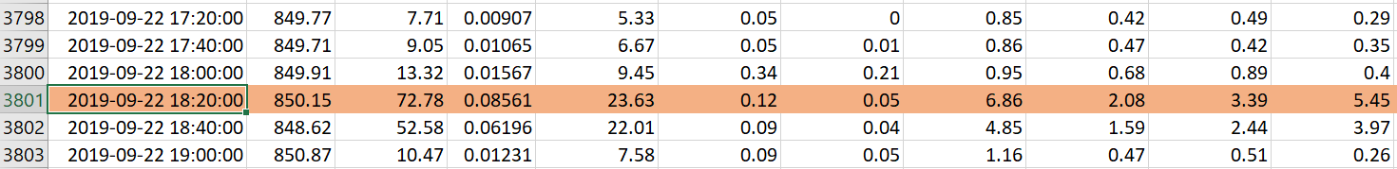
ISRA 5D data
Excel file: UK5 Data Set Definitions and Data Sets
Tab: ISRA 5D Fault Scanner Data
2) Medium spike
Notes:
Indices of the mentioned dates starts at 4525

Slide 6
ISRA 5D data
3) Large
Notes:
Indices of the mentioned dates starts at 4525

Slide 7
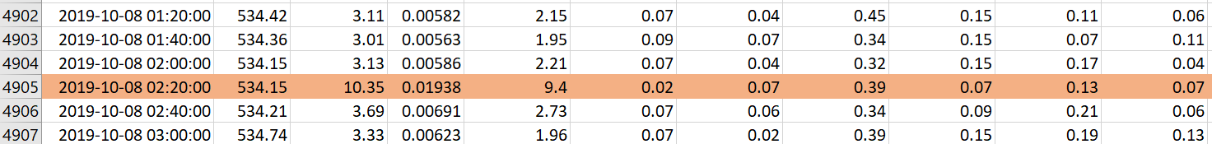
ISRA 5D data
Excel file: UK5 Data Set Definitions and Data Sets
Tab: ISRA 5D Fault Scanner Data
3) Large spike
Notes:
Indices of the mentioned dates starts at 4525

